Slide 1



Vehicle Data
View in Power BI
Last data refresh:
18/09/2022 20:40:46 UTC
Downloaded at:
18/09/2022 20:42:13 UTC

Slide 2
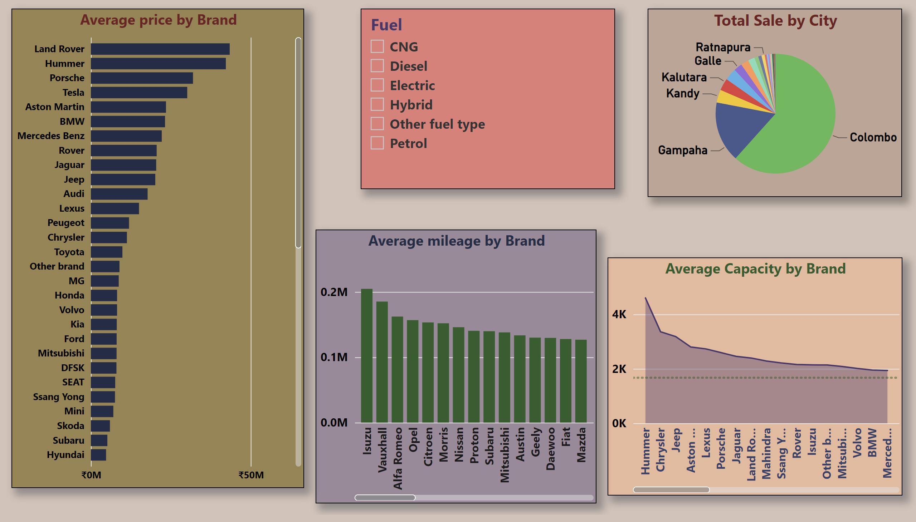
Dashboard
Notes:
barChart
No alt text provided
slicer
No alt text provided
pieChart
No alt text provided
columnChart
No alt text provided
areaChart
No alt text provided

